Slide 1
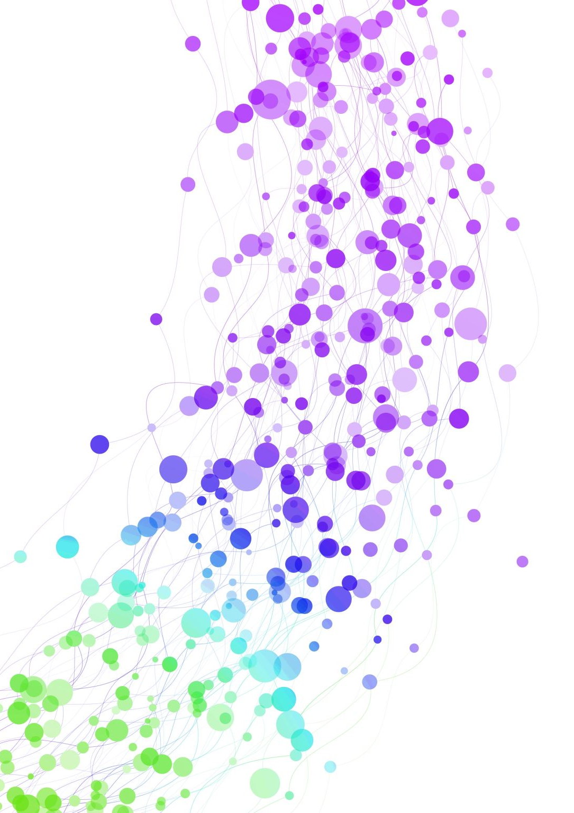
Gradmate COMP 491: Senior Project II
Team: Manan Bhuva Zeel Kukadiya Rudra khunt Urvish Devani

Slide 2
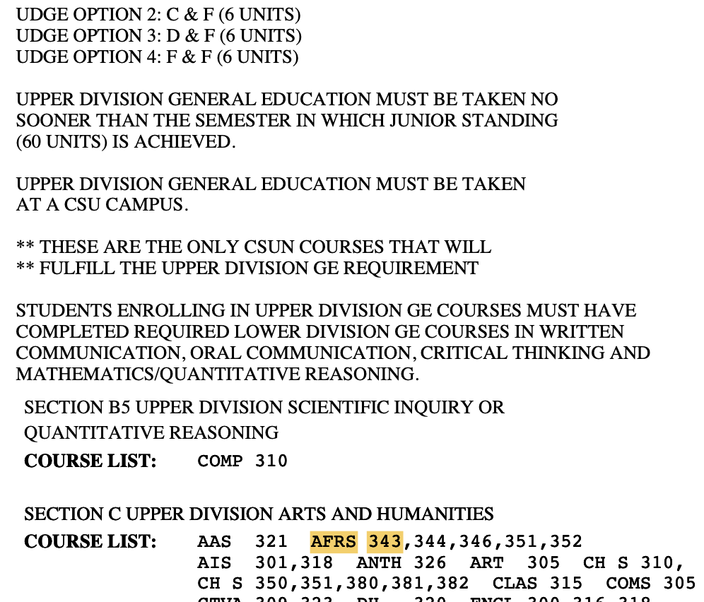
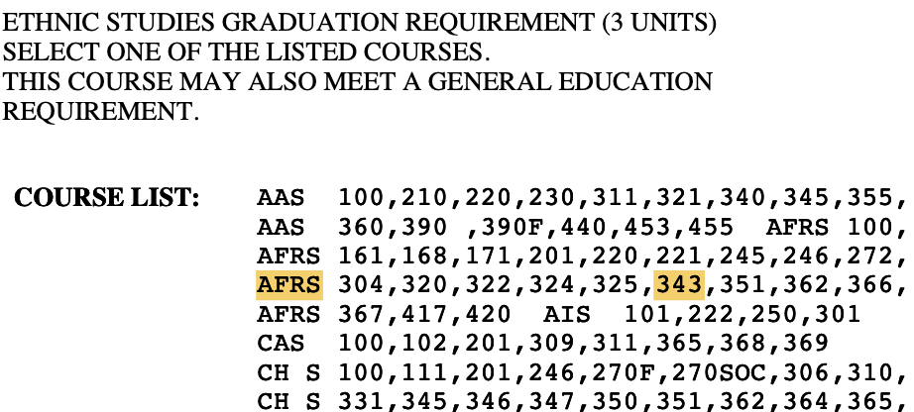
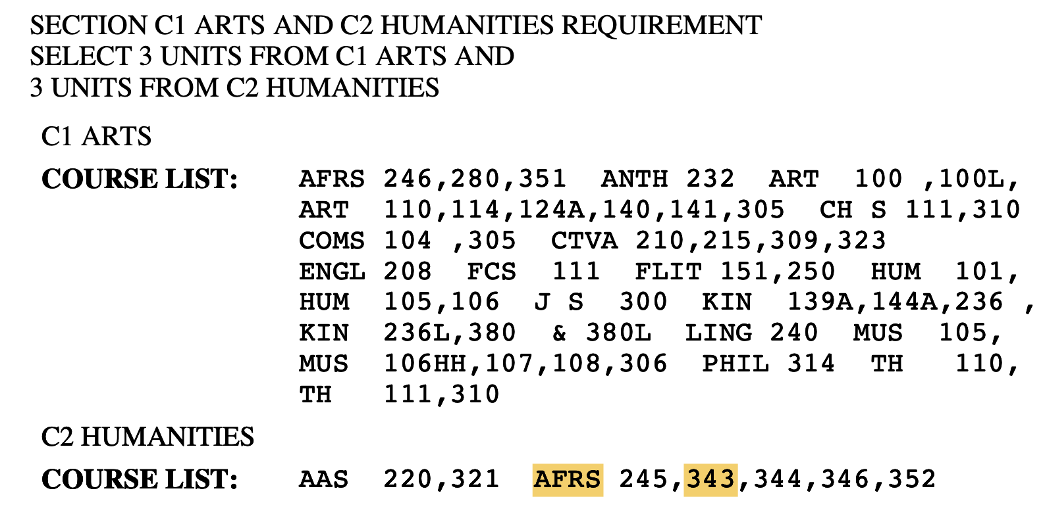
The Problem
Students manually cross-reference DPR PDFs to track graduation progress
Courses double-count across requirement blocks — causing confusion
Planning future semesters with prerequisites & unit loads is complex
International students unfamiliar with GE, UDGE, catalog year, DPR concepts

Slide 3
What is Gradmate?
Django-based web app for CSUN CS students
Upload your DPR PDF → auto-populate completed courses
See real-time degree audit across all requirement blocks
Build a semester plan with auto-suggestions & prerequisite enforcement
Estimates your graduation term
DPR PDF
Gradmate
Graduation Plan

Slide 4
Architecture Overview
Data Model & Requirement Engine
Recommendation Engine
Interface
15-model SQLite schema Rules stored as DB records No hardcoded logic
Scores courses by urgency, prerequisites, term availability, UDGE timing
Dashboard, Audit, Degree Plan (AJAX), Course Catalog

Slide 5
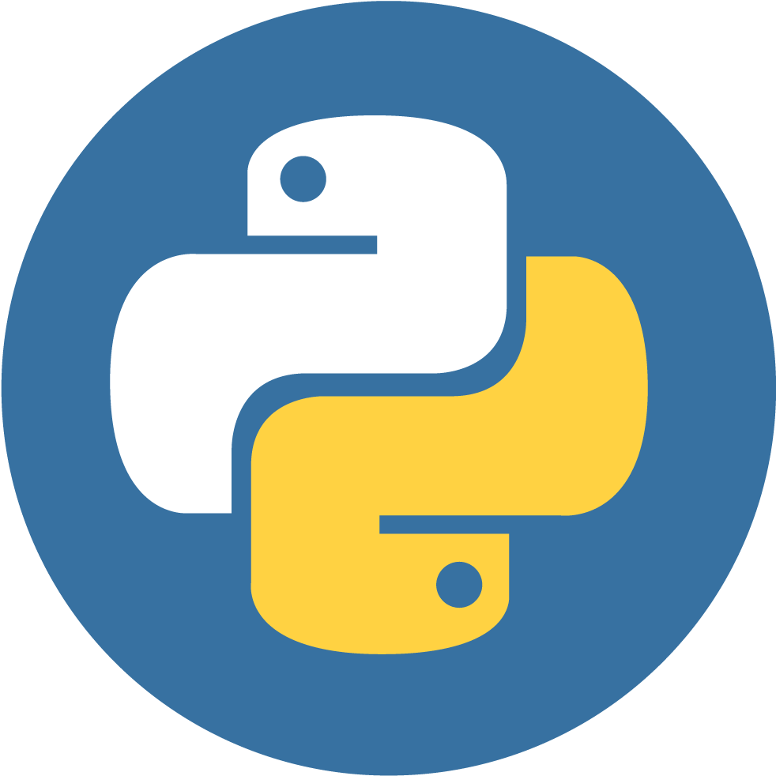

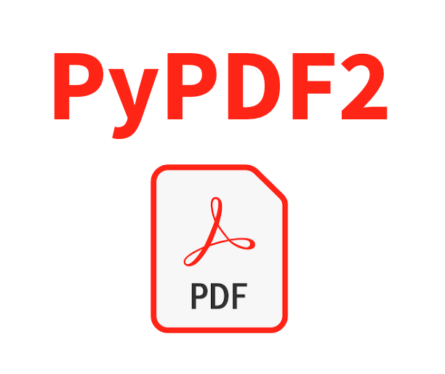



Tech Stack
Layer | Technology
Backend | Python 3, Django 4+
Frontend | Django Templates, Tailwind CSS, Vanilla JS (AJAX)
Database | SQLite (15 models)
PDF Parsing | PyPDF2
Auth | Custom email backend + OTP tokens

Slide 6
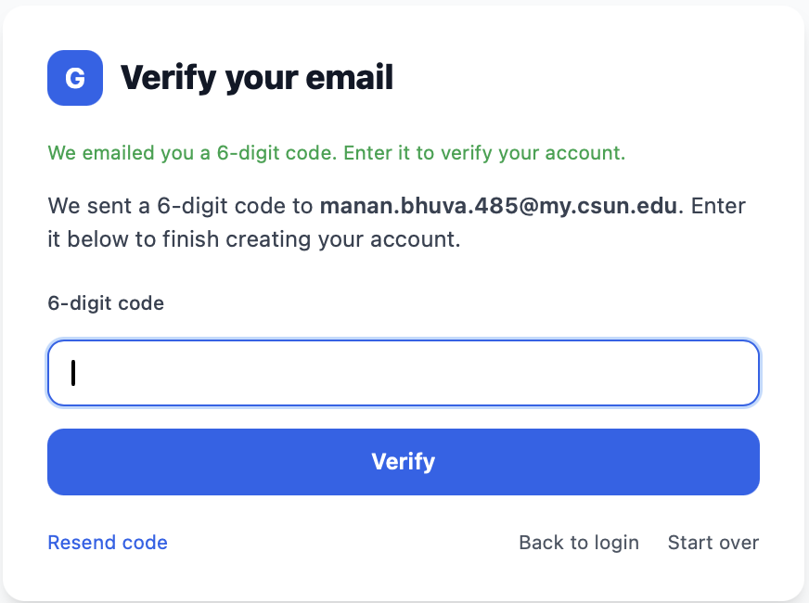
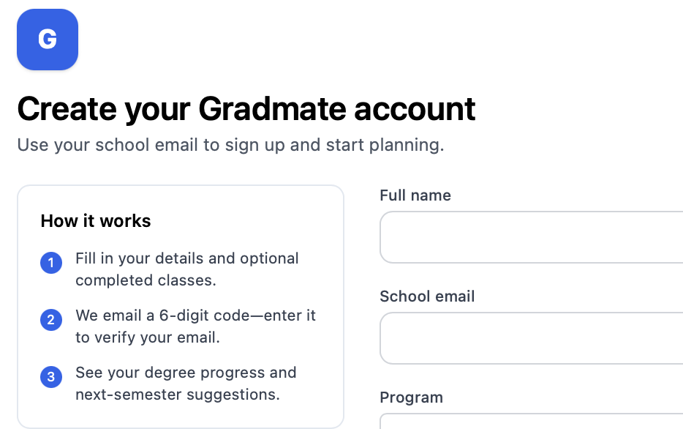
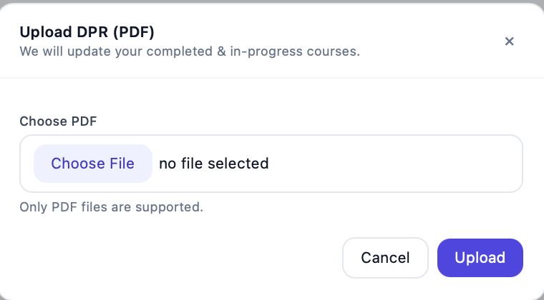
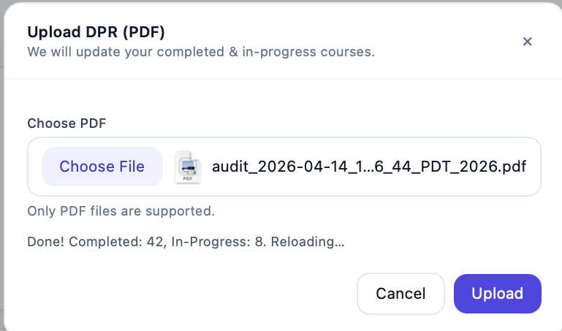
Key Features: Auth & Onboarding
Email signup with OTP verification Profile setup: program, catalog year, credit load target DPR PDF upload → auto-populates completed & in-progress courses Missing catalog courses auto-created on import
Signup
OTP
Profile
DPR Upload

Slide 7
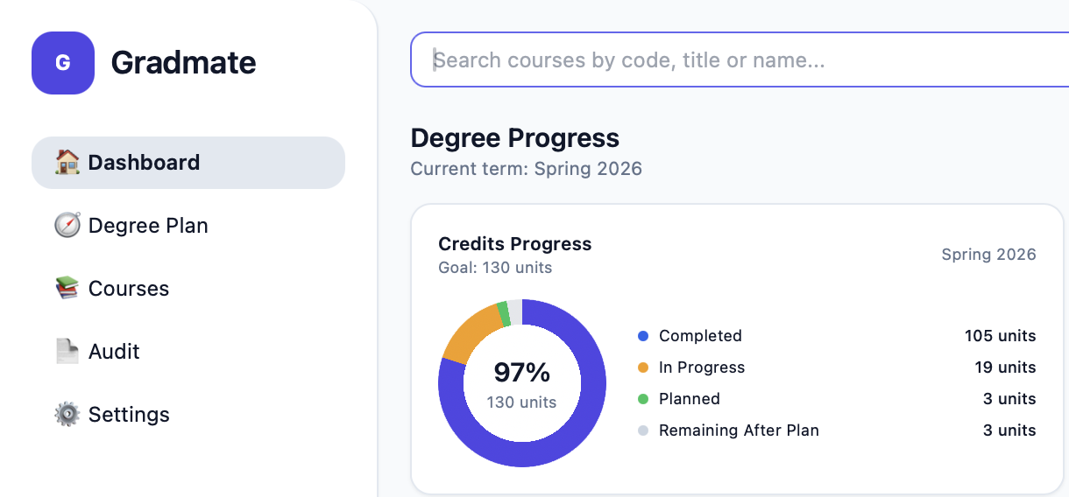
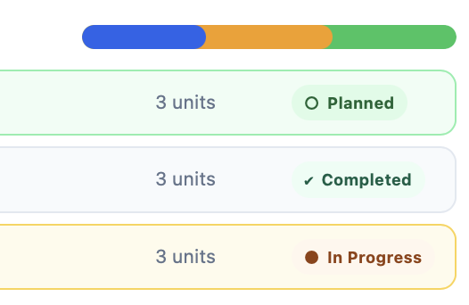
Key Features: Audit & Dashboard
Degree Audit
Dashboard
Every requirement block with satisfaction status Double-counting enforced correctly In-progress course tracking
Progress bars per category Graduation term estimate At-a-glance status overview

Slide 8
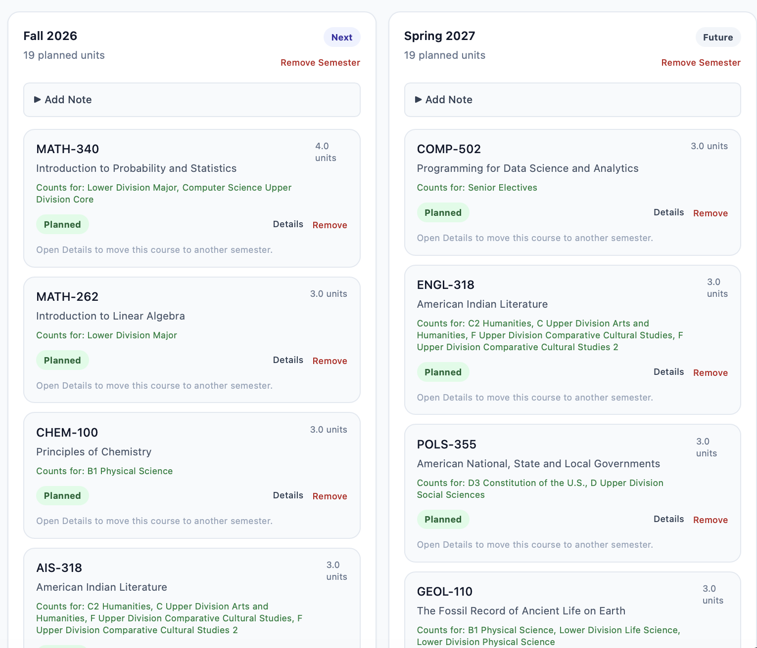
Key Features: Degree Plan
Interactive semester-by-semester plan Add, move, and remove courses with notes Auto-suggest fills up to 4 future semesters Prerequisite chain validation across semesters UDGE 60-unit timing rule enforced

Slide 9
Team Roles
Member | Role
Manan Bhuva | Full-Stack: DB schema, engines, DPR import, AJAX degree plan
Zeel Kukadiya | Database & Integration: catalog data, requirement config, email SMTP
Urvish Devani | Frontend & Research: 18 HTML templates, Tailwind, wireframes
Rudrakumar Khunt | Docs & Deployment: report, README, UML/ER diagrams, testing

Slide 10
Testing
18 functional test cases — all Pass Covers: signup, OTP flows, DPR upload, prerequisite validation, auto-suggest, UDGE rule, audit, dashboard, password reset Edge cases: double-counting, missing catalog courses, corequisite flags Known limitation: no automated test suite; SQLite not production-scale

Slide 11
Future Work
Live CSUN Catalog API integration Mobile responsiveness Schedule conflict detection (day/time) Advisor collaboration portal GPA & grade tracking Multi-university / multi-program support

Slide 12
Demo Video

Slide 13

Thank You

